Slide 1
Nevada Taxation of Cannabis Study
Notes:
Good afternoon Cannabis Advisory Commission, my name is Erica Scott, Economist at the Department of Taxation and chair of the CAC subcommittee on the Taxation of Cannabis.

Slide 2
AB76
Elimination of Wholesale Cannabis Tax with an Increase to Retail Cannabis Tax
Addition of Consumable Hemp Excise Tax
Notes:
This slide was just the brief overview of AB76 requirements for the subcommittee to study first, the elimination of Wholesale Cannabis Tax with an increase to Retail Cannabis Tax, which would be at least revenue neutral to the State Education Fund. Second, potential effects if the state enacts an Excise tax on consumable hemp, notably intoxicating hemp.
Additionally, the subcommittee would assess any such other tax changes to be made and although there were initial discussions of ideas on possible other changes, none were pursued for full assessment as tax structures became more complicated for industry in those scenarios. The assessments done for this study were for the above two scenarios only.

Slide 3
History of Cannabis Excise Tax in Nevada
Notes:
The study begins with a History of Cannabis Excise tax in Nevada and also licensed industry's tax obligations overall.

Slide 4
Cannabis Subject to Tax
FY 2017: Legalization of recreational cannabis
  15% Wholesale Excise Tax
  10% Retail Excise Tax introduced for adult-use cannabis
Retail Excise Tax distributions: State Education Fund.
Wholesale Cannabis Tax Distributions: Local governments, regulatory operations, State Education Fund
Over $700M generated for Nevada schools since 2018.
Medical and Adult-Use cannabis sales subject to local sales tax between 6.85%-8.375%
Medical cannabis subject to Wholesale Tax, but exempt from Retail Excise Tax
  Wholesale Tax embedded in retail price of Medical Cannabis
Notes:
With the 2017 legalization of cannabis came the 15% Wholesale Tax, subject to the initial transfer of the raw cannabis from the grower; and the 10% Retail Excise tax, subject to the retail price of the cannabis sold to the end consumer. The Retail Excise Tax distributes directly to the State Education Fund while the Wholesale Tax distributes to local governments, regulatory operations and the State Education Fund. Since 2018 through Fiscal Year 2025, this source of revenue has generated over $700 million to Nevada Schools. In addition to Excise Taxes, licensed cannabis is subject to the local sales tax between 6.85% and 8.375% in Nevada. Medical Cannabis is subject to the Wholesale tax, but exempt from the Retail Excise Tax so the Wholesale Tax is embedded in the retail price of Medical Cannabis.

Slide 5
Other Taxes and Licensing Fees
Gross Sales Fees
  Counties Permitted to assess up to 3% of Gross Revenue
Flat Fees
  Local Licensing with various fee structures
Federal Tax Restrictions – IRS Code 280E
  Cannot deduct ordinary business expenses due to the Federal Schedule I status
  Only Cost of Goods Sold (COGS)
  Effective Tax Rates may exceed 70%
Notes:
The licensed cannabis industry is subject to additional tax and fee structures at the county and local licensing level and additional Federal Tax rates due to the Schedule I status. These fee structures vary widely across Nevada’s 17 counties.
Clark County, for instance uses tiered licensing fees while others use flat-rate or steep initial fees. This variability creates differing business environments across the jurisdictions. At the Federal level due to the Schedule I status, these businesses cannot deduct ordinary business expenses, resulting in a tax rate that may exceed 70% and situations where the business owes taxes even when operating at a loss.

Slide 6
Current Market
Cannabis Excise Tax Revenue peaked in FY 2021
40% decrease in Cannabis Excise Tax Revenue distributed to State Education Fund
  (FY 2021 to FY 2025)
Steady price decline for cannabis
Maturing Market
Notes:
So we reviewed the history and current tax application to licensed cannabis, which brings us to why we’re looking at this study. Cannabis Excise Tax Revenue peaked in Fiscal Year 2021, to which distributions to State Education Fund in Fiscal Year 2025 were 40% less. We’ve seen this steady price decline of cannabis over the years, which you would see in a mature market.

Slide 7
Nevada Licensed Cannabis Sales Analysis
Notes:
Now I’ll move on to the bulk of what this study has to offer which is our Nevada Licensed Cannabis Sales Analysis.

Slide 8
Sales Analysis Overview
Dataset: January 2019 – December 2025 Sales Recorded in METRC
8,374 observations: Monthly Sales Total by Cannabis Category by County
  Includes 11 counties and 28 product categories
  The 28 categories were later aggregated to 10 for final analysis
  7 of those categories made up 99.3% of sales
Approximately $5.46B in Sales, 550.5M Units/Grams, 150.7M transactions
Notes:
The subcommittee gathered the past 7 full years of sales data recorded in the state’s seed-to-sale system, METRC, which is the most comprehensive analysis of Nevada’s licensed cannabis market that has been done to date. It was most important to include recent data to encompass the post-COVID market activities that are “normalized” if you can say that. This dataset includes January 2019 to December 2025, which is 8,374 observations of monthly sales by category by county. These 8,374 observations includes 11 counties and originally 28 METRC product categories, which were then aggregated to 10 categories for final analysis. Seven of those categories make up 99.3% of the sales. This totals approximately $5.46 billion in sales, 550.5 million units/grams amongst 15.7 million transactions.

Slide 9
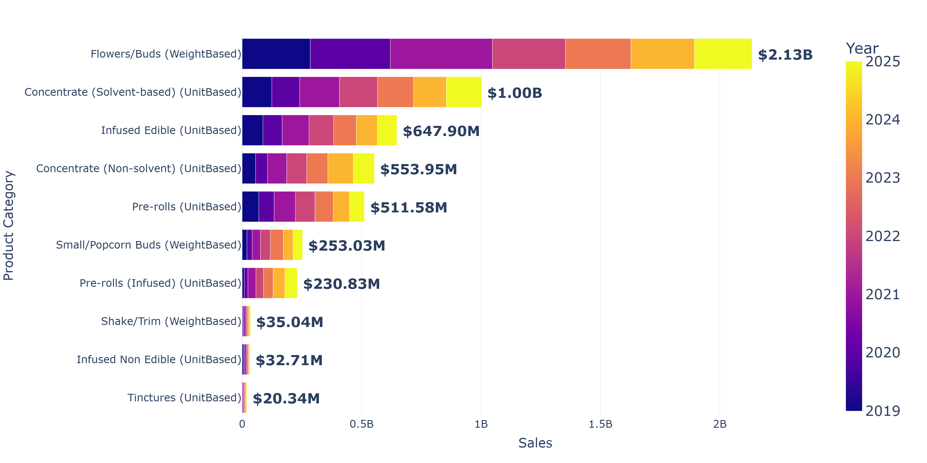
7 Years of Nevada Cannabis
Notes:
We broke out the data into 10 categories: flower, Solvent Based Concentrates, Infused Edibles, Non-Solvent based concentrates, Pre-Rolls, Small Bud, Infused Pre-Rolls, Shake or Trim, Infused Non-Edibles (like lotions, etc.) and finally, Tinctures. We can see the absolute highest demanded product category is flower and this has been consistent over the 7 years of data. Over $2 billion in flower has been sold in Nevada in those seven years followed by Solvent-Based Concentrates at $1 billion as second most popular category, then Infused Edibles as the third most popular category at about $648 million in sales. For reference, this is Figure 1 from the Appendix Technical Analysis section in the study document.

Slide 10
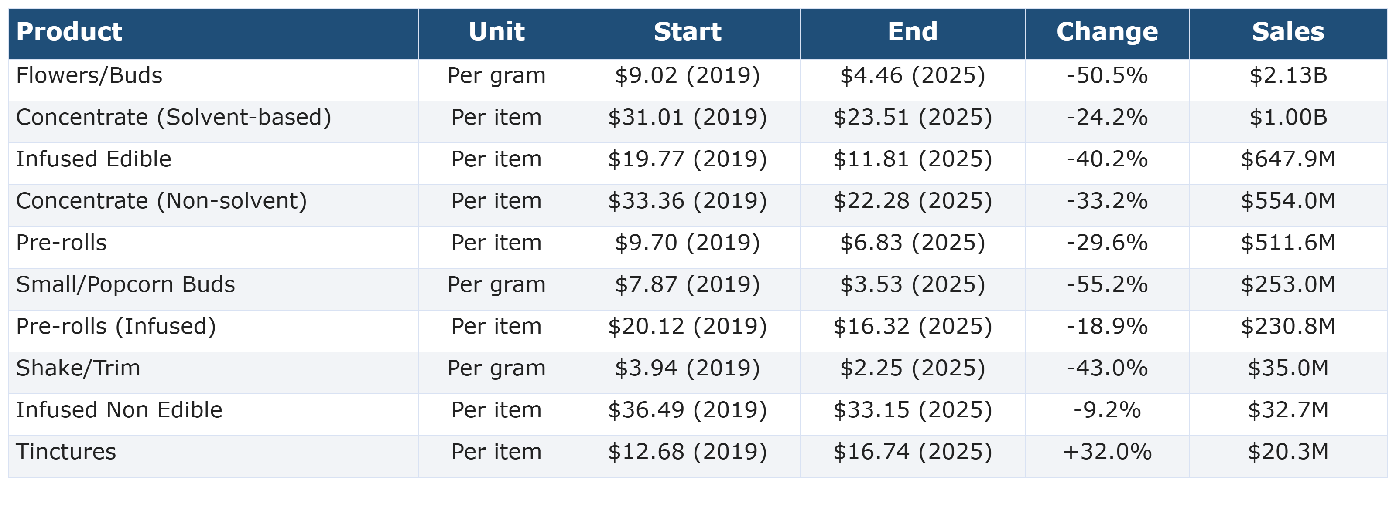
Annual Price Trends
Notes:
This is Table 1 from the study. We can see broad price compression between 2019–2025. Flower prices declined from $9.02/g to $4.46/g or 50%. Edibles & concentrates show around 24–40% price declines. Overall, the annual price trends indicate that the Nevada cannabis market became less expensive for many of the largest product categories over the period analyzed. This price compression could be reflective of a combination of factors: market maturation, increased competition, production efficiencies, technological advancements, or greater availability of lower priced products, which in this market would be illicit products and intoxicating hemp.

Slide 11
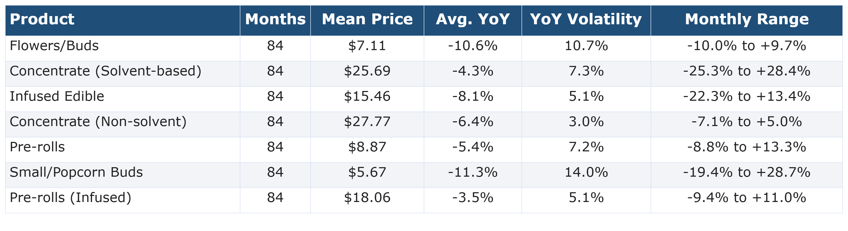
Monthly Price Variation
Notes:
On this table, which is Table 3 from the Technical Analysis, we looked Monthly Price Variation for the top 7 categories, the categories making up 99.3% of the sales. While all major categories experienced negative Year-over-Year price changes, there are product categories that experienced both a sustained downward price trend and relatively substantial short-term price fluctuations. While weight-based categories seemed to exhibit more volatility, unit-based products displayed more gradual and consistent price trajectory.

Slide 12
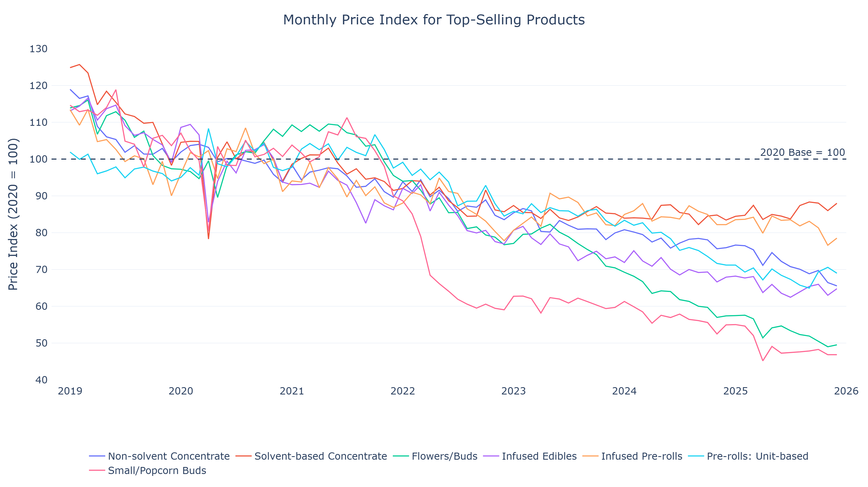
Notes:
This slide is Figure 3 from the study and provides another look at the top 7 categories over time displaying the overall downward price trend with more volatility for some categories. For example, Small Bud category is the magenta-colored line displaying a large drop after 2022, with some steadying there after. And at top the orange-colored line showing Solvent-Based Concentrates on a price increase into 2026.

Slide 13
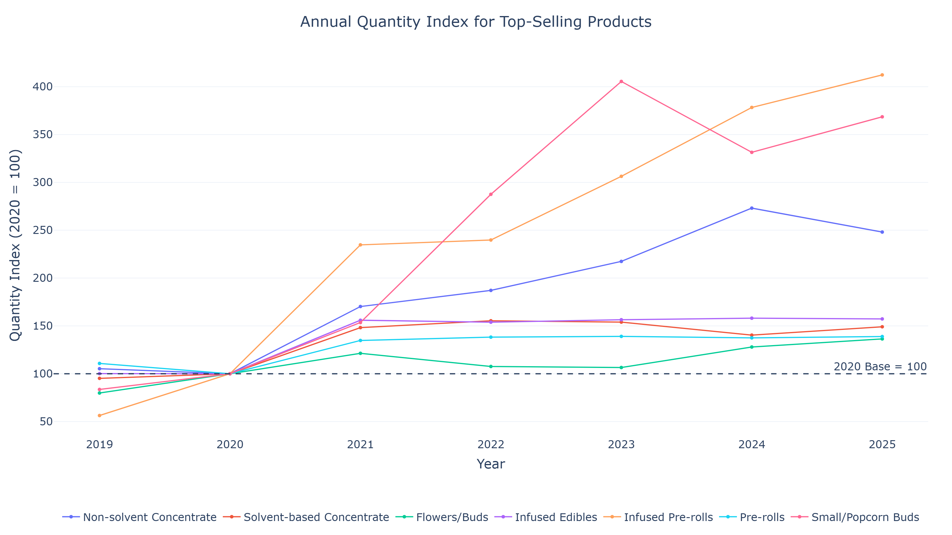
Quantity Demanded by Category
Notes:
Now that we’ve reviewed the declining price trend, we need to review Quantity and Number of Transactions. Figure 4 from the study provides the Quantity Demanded Trend among the top 7 product categories. Demand growth varies widely across product categories, but we can see the overall quantity increase in product sold. While Infused Edibles, Solvent-Based Concentrates, Flower and Pre-Rolls maintained steady quantity demanded, Infused Pre-Rolls, Non-Solvent Based Concentrates and Small Bud dramatically increased. Additionally, the number of transactions observed also increased.

Slide 14
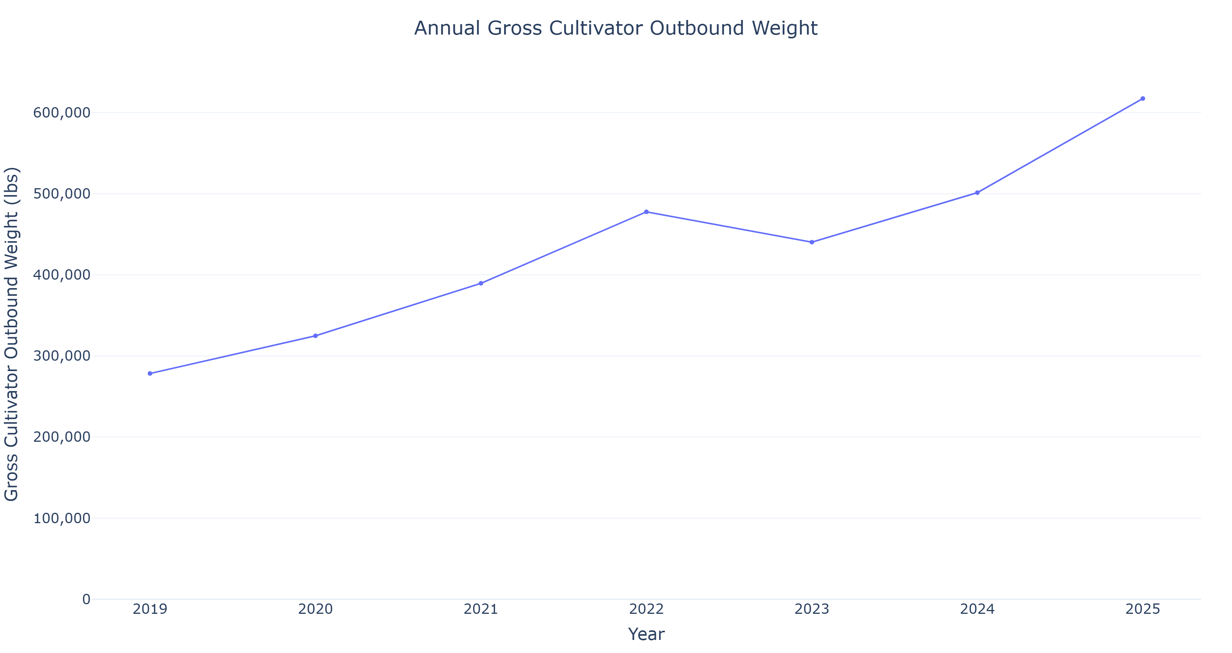
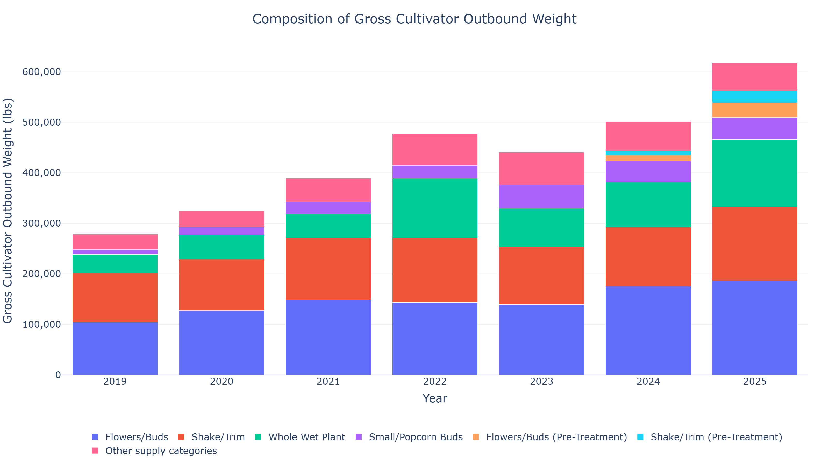
Outbound Cannabis from Cultivation Licensees
Notes:
A review of the supply side of the cannabis industry also shows increased production of cannabis over the years. These transactions represented consist of the transfers from Cultivation licensees out to another license and are not all necessarily straight to market, but the data does indicate supply. There are some issues with these transactions as some product does not make it all the way to market, but overall, the trend of cultivation transfers has increased, indicating sufficient supply. The outbound weight increased by 121.8% from 2019–2025 with upstream movement of product while retail prices fell.

Slide 15
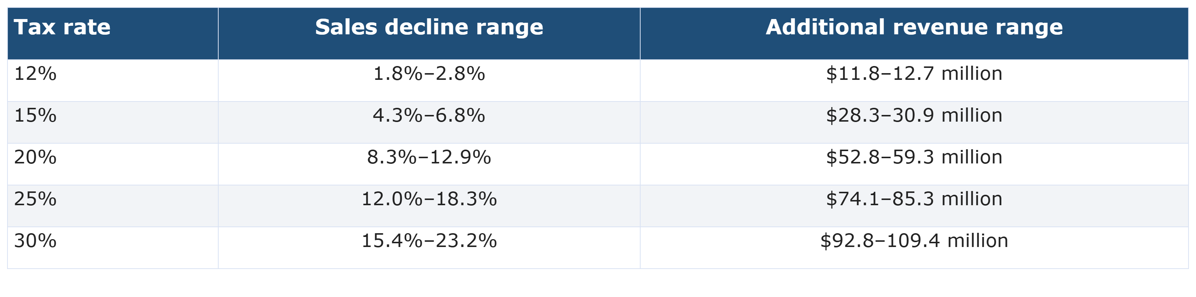
Elimination of Wholesale Excise Tax & Increase to Retail Excise Tax
Policy Scenario Results
Notes:
After analyzing Price Elasticity and running rigorous tests, the study concluded the section for the scenario of eliminating Wholesale Excise Tax with an Increase to Retail Excise Tax. Using Fiscal Year 2025 revenues as the example, eliminating the Wholesale Excise Tax reduces the State Education Fund by $21 million, but an increase of Retail Cannabis Tax of 2-5% bringing the total Retail Cannabis Tax to 12-15%, would increase the state education fund by $11.8 to $30.9 million.

Slide 16
Eliminating Wholesale Excise Tax & Increasing Retail Tax
Retail Excise Tax Rate Set between 12% to 15%
Existing distributions currently funded through the Wholesale Cannabis Tax would also need to be addressed through the Retail Cannabis Excise Tax
Notes:
The subcommittee does not make a recommendation whether the Wholesale Cannabis Tax should be eliminated, rather if this is pursued by the Legislature, the rate at which Retail Excise Tax should be increased is to a rate between 12 and 15%. There is the added issue of addressing the distributions to regulatory actions and to Local Governments. The study recommends that the $5M to Local Governments be evaluated since all active counties are enacting the 3% additional licensing fees, but also that the regulatory agency operate from the funds of the Retail Excise Tax as well. Medical Cannabis would not be impacted in the short run since the assumption is cultivators would not be dropping the price immediately and instead, maintaining the previously paid 15% tax as profit. And since Medical Cardholders do not pay Retail Excise Tax, the price would not change for Medical Cardholders.

Slide 17
Implementation of Intoxicating Hemp Excise Tax
Notes:
Now we will shift gears to the study of implementation of an Excise Tax on Intoxicating Hemp.

Slide 18
Intoxicating Hemp
Industry born out of the 2018 Farm Bill Loophole
Clark County now requiring licensing and testing for Hemp Retailers (July 2026)
Federal Uncertainty due to Agriculture Appropriations Act 2026
  Extension to December 2026
No solid Nevada data
Limited number of states with similar market to Nevada
Minnesota most similar market and tax structure
Notes:
Since the prior presentation went into the details happening at the Federal Level as to why this market exists, I will skip that portion. However, I will speak more to the available data that we were able to use for the study. At the outset, there were many states with data available, like Florida, Texas, etc. But these markets did not have a licensed Cannabis market established in the state, meaning consumers could only purchase hemp. Meanwhile, Nevada has established a robust regulated cannabis industry for nearly a decade. The only state with a somewhat similar tax structure and a somewhat similar market is Minnesota.

Slide 19
Minnesota Comparison
Legalized Hemp in 2015
Legalized Recreational Cannabis in 2023
Similar Excise Tax initially 10%, but increased to 15%
Similar Sales Tax 6.875% (state base)
Population roughly 77% larger than Nevada
Notes:
The Minnesota comparison to Nevada holds up relatively well in that an Excise Tax was established at 10% in 2023, but has increased to 15% in 2025. There is also a similar established state sales tax at 6.875% to Nevada’s 6.85%. However, Minnesota’s population is 77% larger than Nevada’s so that was factored into the estimation of tax revenue.

Slide 20
Enacting Intoxicating Hemp Tax
Large Range due to many assumptions and uncertainties
At 10% Rate adds $4.3M
At 12 to 15% Rate adds $5.16M to $6.45M
Minimum Range $0.00 Added Should the Intoxicating Hemp Market cease to exist determined by Federal Definitions
Recommendations for Intoxicating Hemp Industry to be regulated as Cannabis Industry with the same tax structure
Notes:
The revenue estimated from the Minnesota data provided a market in Nevada of roughly $42.7M a year. At the 10% Retail Excise Tax rate would add $4.3M to Nevada’s revenues, or between $5.16M to $6.45M at the 12% to 15% rate discussed earlier in the study. Should this tax be enacted with the Wholesale Tax still remaining, the wholesale tax would also need to be addressed by the Intoxicating Hemp industry. This body overall recommends that the Intoxicating Hemp industry be regulated similar to the licensed Cannabis Industry since the existence of the market is born out of the Federal Loophole and demand for the intoxicating hemp would be satisfied with the licensed cannabis market otherwise.

Slide 21
Conclusions
If Wholesale Tax Eliminated With Increase to Retail Excise tax
  Retail Excise Tax Rate to be set at 12% to 15%
  Distributions from Wholesale Tax be addressed by Retail Excise Tax
If Intoxicating Hemp Excise Tax enacted
  Same rate of tax and regulatory structure be applied as Cannabis
Notes:
To bring this presentation to a close, I’d like to restate the subcommittee’s recommendations: First, should the legislature pursue the elimination of Wholesale tax and Increase the Retail Excise Tax, the rate should be set between 12% and 15% with distributions addressed similar to Wholesale tax. And Second, If an Intoxicating Hemp Excise Tax is pursued, the tax and regulatory rates should be in parity with the Cannabis industry.

Slide 22
Thank You
Notes:
With that I conclude the presentation and am available for any questions. Thank you.

